Slide 1
Machine learning with Tensorflow
Stud. R.Komaristova
PI17S

Slide 2
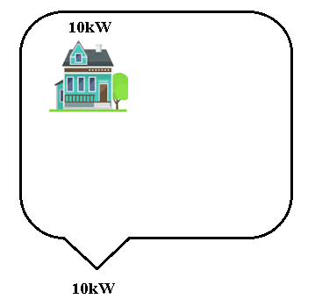
Problem to solve

Slide 3
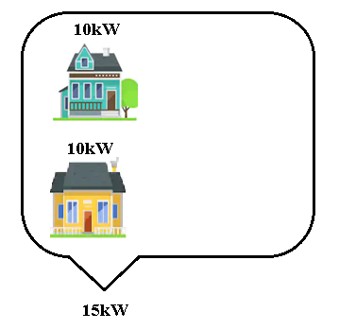
Problem to solve

Slide 4
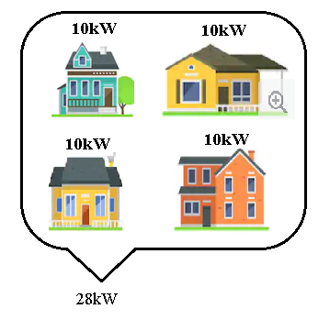
Problem to solve
Total power = coef * ∑(houshold)

Slide 5
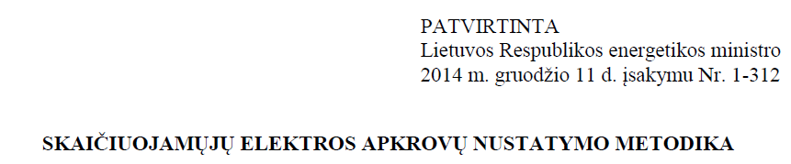
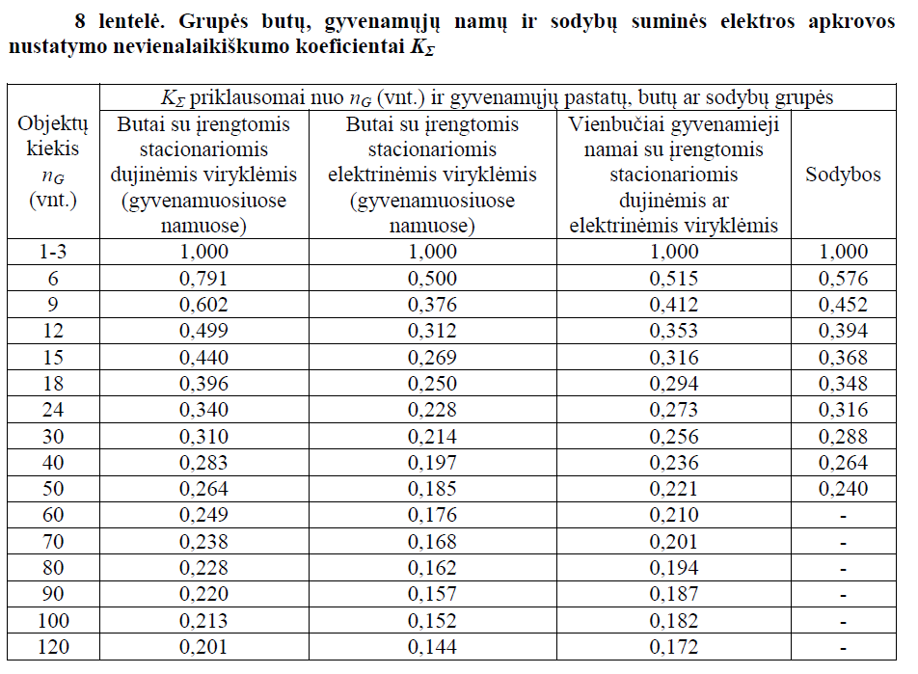

Slide 6

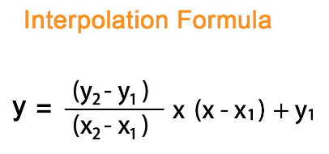
Coefficient calculation

Slide 7
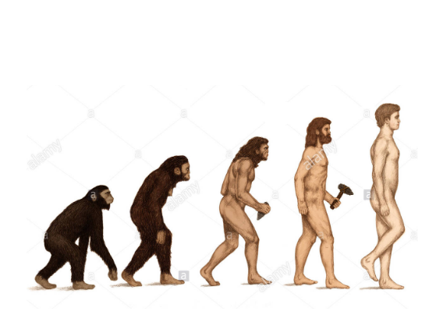





Coefficient calculation

Slide 8


TensorFlow is an end-to-end open source platform for machine learning.
It has a comprehensive, flexible ecosystem of tools, libraries and community resources that lets researchers push the state-of-the-art in ML and developers easily build and deploy ML powered applications.
It looks like magic.

Slide 9
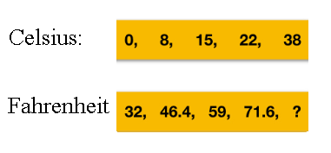

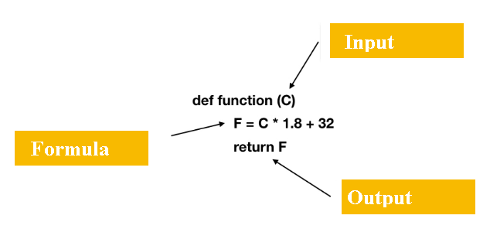
Celsius to fahrenheit

Slide 10
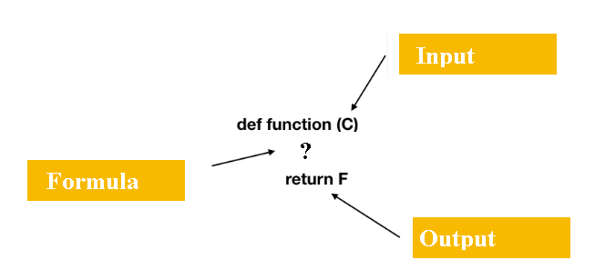

Celsius to fahrenheit

Slide 11
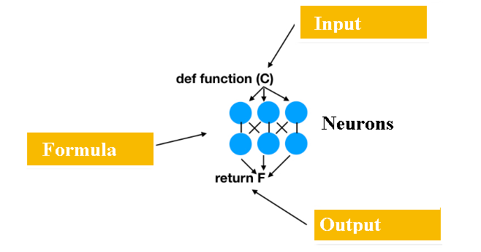
Celsius to fahrenheit

Slide 12
Let’s try!
1) Make imports (Python)
Tensorflow – machiene learning;
Numpy – work with arrays
Pyplot – plot graphs
from __future__ import absolute_import, division,print_function,unicode_literals import tensorflow as tf import numpy as np import matplotlib.pyplot as plt
2) Create data arrays:
data – quanties of households of one type
koef – coefficients for given quantities from table
data = np.array([2, 5, 6, 7, 9, 10, 11, 12, 15, 18, 20, 24,25, 30, 35, 40,45, 50,55, 60,65, 70, 80, 90, 100, 120], dtype=float) koef = np.array([1, 0.861, 0.791, 0.728, 0.602,0.568,0.533, 0.499, 0.440, 0.396,0.377, 0.340,0.335, 0.310, 0.296, 0.283, 0.273, 0.264,0.257, 0.249, 0.243,0.238, 0.228, 0.220, 0.213, 0.201], dtype=float)

Slide 13
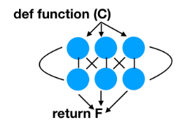
Let’s try!
3) Create layers
l0 = tf.keras.layers.Dense(units=10, input_shape=[1]) l1 = tf.keras.layers.Dense(units=1) model = tf.keras.Sequential([l0, l1])
4) Train model
model.compile(loss='mean_squared_error', optimizer=tf.keras.optimizers.Adam(0.01)) history = model.fit(data, koef, epochs=500, verbose=False)

Slide 14
Let’s try!
3) Create layers
l0 = tf.keras.layers.Dense(units=10, input_shape=[1]) l1 = tf.keras.layers.Dense(units=1) model = tf.keras.Sequential([l0, l1])
units – number of neurons in layer
input_shape – quantity of input parameters (we pass 1 parameter – number of households)
loss – way to measure accuracy of machine calculated result
optimizer – function of selecting inner parameters to achieve better result
epochs - number of training iterations
4) Train model
model.compile(loss='mean_squared_error', optimizer=tf.keras.optimizers.Adam(0.01)) history = model.fit(data, koef, epochs=500, verbose=False)

Slide 15
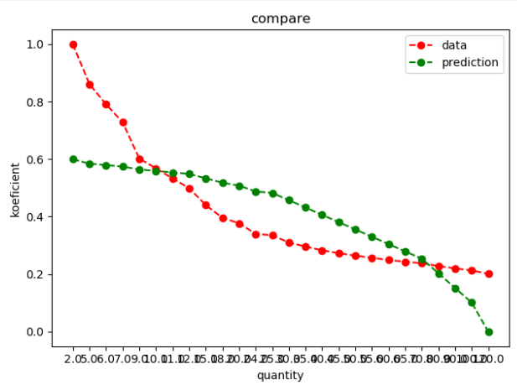
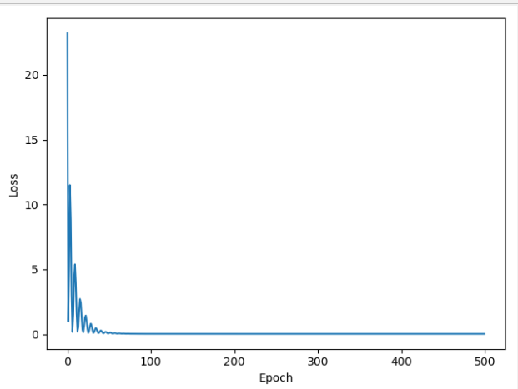

Run!
model.predict(data)

Slide 16

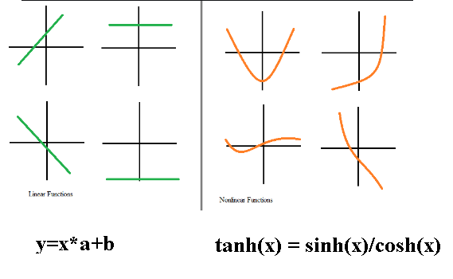
Choose correct activation function

Slide 17
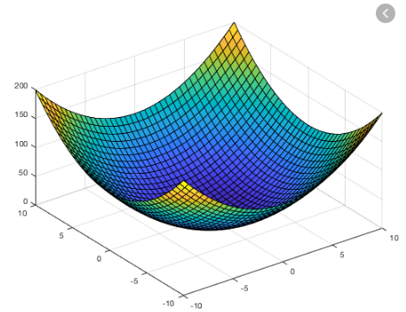
Y=x *a +b
‘a’ and ‘b’ are weights
On each training iteration program tries to select good enough weights, so that loss -> min

Slide 18
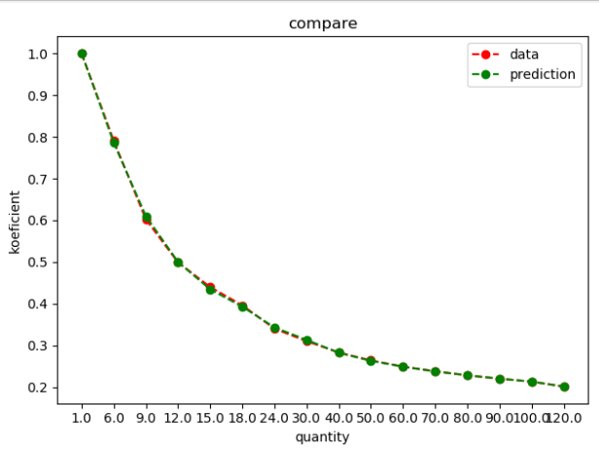
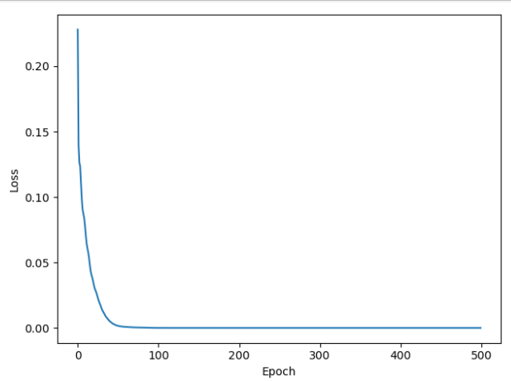
Let’s try!
Change activation function
model = tf.keras.Sequential() model.add(tf.keras.layers.Dense(20, activation="tanh", input_shape=[1], kernel_initializer="uniform")) model.add(tf.keras.layers.Dense(1, activation="linear", kernel_initializer="uniform")) model.compile(loss='mean_squared_error', optimizer=tf.keras.optimizers.Adam(0.01))

Slide 19
More complex data
Add building types:
First parameter – household type
Second parameter – quantity of households
data = np.array([ [1,1], [2,1], [3,1], [4,1], [1,6], [2,6], [3,6], [4,6], [1,9], [2,9], [3,9], [4,9], [1,12], [2,12], [3,12], [4,12], [1,15], [2,15], [3,15], [4,15], [1,18], [2,18], [3,18], [4,18], [1,24], [2,24], [3,24], [4,24], [1,30], [2,30], [3,30], [4,30], [1,40], [2,40], [3,40], [4,40], [1,50], [2,50], [3,50], [4,50] ], dtype=float)
2) Change input shape
model.add(tf.keras.layers.Dense(10, activation="tanh", input_shape=[2],
kernel_initializer="uniform"))

Slide 20
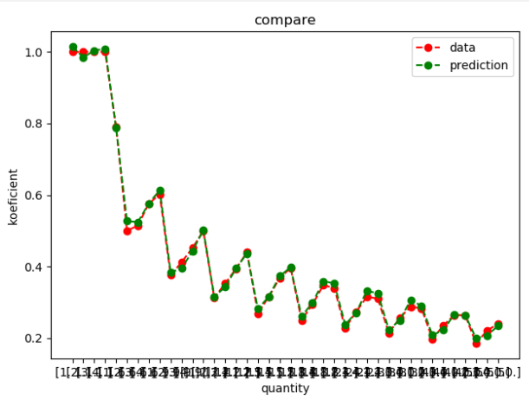
More complex data

Slide 21


